Slide 1
MODULE 5 ..PART1..IRS INDEXING & SEARCHING
Module6..
1)User interface requirement (good and bad interface).
2) Video information retrieval,
3) image information retrieval
4) 3D retrieval
5) audio and music retrieval

Slide 2
MODULE 6 ..PART1..IRS IMAGE.TEXT VIDEIO
1)interface… we have IRS. To this we as a user have to connected.
1.1)Input ..data to be given to the system…called as input interface
1.2)Output…data to be read fro the system..called as output interface
1.3)These interfaces have to be user interfaces…i.e made from user point of view. Will make the user comfortable in using the input and output devices
1.4)Now one step ahead…user interactive design…making the devices so comfortable, enjoyable and useable to the user i.e the user should fell comfortable in interacting with the devices
2)interactive design…2.1)general definition….The process of designing usable interactive product.

Slide 3
MODULE 6 ..PART1..IRS IMAGE.TEXT VIDEIO
2)interactive design…2.2)What is to be considered for this…
a)Who is going to use then…diverse type of users
b)How they are going to use them..by touch, speech, voice…
c)Where they are going to be used….near, remote
d) Kind of activities which people will do with the product…enter, select, read
e)Consider computer, it can be used in many application like programming. typing, messaging, games, watching movies, net surfing, control power plants, making slides, educations shares, banking, railway booking and so on…
f) Consider the ISR system and apply a, b,c and d points to it

Slide 4
MODULE 6 ..PART1..IRS IMAGE.TEXT VIDEIO
2)interactive design…2.2) what to be considered..cont
g)Thus the ways in which the users will interact with the system is also diverse…different types of input and output devices are present for touch, speech, action, signal type.
2.3) Conclusion….
a)system with different and varying functions..
b) Users ..diversified
c) Product usage…different angles
d) environment….different as per requirements
e) Input & output devices…different types

Slide 5
MODULE 6 ..PART1..IRS IMAGE.TEXT VIDEIO
2.3)Conclusion….cont
Thinking on these lines, instead of ALL we will provide optimized solution
2.4)Solution….
Optimization of the users interaction with the environment, system and the product.
2.5)how to provide?... For this…..
a)Consider what people are good and bad at…
b)What will help people with their current way…
c)Listening to people as what they want…
d) Use tried & tested user based techniques during process design…

Slide 6
MODULE 6 ..PART1..IRS IMAGE.TEXT VIDEIO
2)Interactive design.. 2.5)how to provide?...cont
e)Designing a product to support the way people communicate and interact in their everyday and working lives.
f)Designing a space for human communication and interaction with the product.
2.6)Conclusion…
It basically promotes the use of a range of methods, techniques and framework.
3)Components of interactive design…..
a) Graphic design…..for GUI and page layout
b) Product design……for system design phases
c) Aesthetics design…..for look and feel

Slide 7
MODULE 6 ..PART1..IRS IMAGE.TEXT VIDEIO
4)Components of interactive design…..
d) Information system…..for collecting right information so as to provide right information
e) Human computer interaction…for understanding the computer systems interaction with human from the users perspective
f) Cognitive engineering….find out how the user will think and behave.
h) Human factor science…..human aspect requirements.
i) Social science…how user will interact with others.
j) Computer science….computer design aspect.
k) Psychological study…..human emotions and moods.
l) informatics….collection of required data.

Slide 8
MODULE 6 ..PART1..IRS IMAGE.TEXT VIDEO
5)Who is involved in interaction design
a)Designers need to know business side, technical side, manufacturing side & marketing side.
b) Different things about users, technology and interaction between them.
c) How people act and react to different events.
d) How they communicate and interact with each other.
e) How emotions work.
5.1) Conclusion…
This is not the work of a single developer but a multi disciplinary team where the skill sets of engineers, designers, programmers, psychologist, sociologist, artist , toy makers and many others are polled together.

Slide 9
MODULE 6 ..PART1..IRS IMAGE.TEXT VIDEIO
5) Interactive design….5.2)Advantages….
a)People with different background and skill sets are brought together.
b)New methods are developed, new ideas are put in, more creative & original designs are provided.
c)Scope of discussion focused from different viewpoints.
5) Interactive design…5.3) Disadvantages……
a)More the number of members, more the discussion, their can be more confusion, misunderstanding and breakdown in communication.
b) People with different ways of thinking may be in a team which
may lead to less or no communication between them.

Slide 10
MODULE 6 ..PART1..IRS IMAGE.TEXT VIDEIO
6) Process of interaction design….
a)Identifying the needs for user experience…
a.1)User experience means what the users want from the product what is his experience, Good or bad.
a.2)We aim at good user experience, so on those line identify the needs, i.e the user going to hold the product, yes or now, user going to read from it, User going to write into it, listen from it, search from it and so on.
b)Establishing requirements for user experience…
b.1)Once the needs are fixed then establish what will the requirements to be satisfied for those needs.
b.2)These requirements can be fixed again after examining the users experience about similar type of products.
b.3)It also depends on the type of users, environment of use, etc.

Slide 11
MODULE 6 ..PART1..IRS IMAGE.TEXT VIDEIO
6) Process of interaction design….cont
c) Developing alternative design that meet these requirements.
c.1)Number of requirements are collected from the users and various different designs are made instead of only one.
c.2)These designs are then evaluated with a team of pilot users who are involved with the design right from the start.
d) Building interactive versions of the design so that they can be communicated and accessed.
d.1)Their are many different ways by which the user is made to communicate with the product so as to access it.
d.2) Their can be walkthrough. Interviews, feedback, by questionnaire, observing them do different task, etc..

Slide 12
MODULE 6 ..PART1..IRS IMAGE.TEXT VIDEIO
6) Process of interaction design….cont
e) Evaluating what is being built through out the process and the user experience it offers.
f) There are set points introduced in the design process were the product in process in evaluated for its users experience.
g)This can be done by interviews, feedback, observation or questionnaire.
h) This is done to find out how the users interact with the product and also with each other so as to share their experience.
i)The study of were and how the users live is done so as to better understand them. This thus prevents the designers from doing irrelevant assumptions.
j)Evaluating their cultural difference, social interaction, etc also helps the designers to evaluate the user groups in a better way.

Slide 13
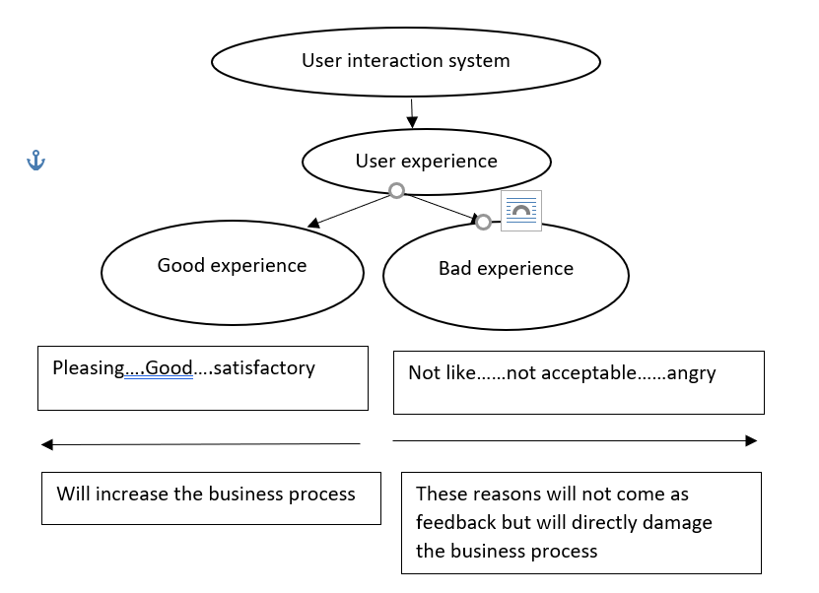
MODULE 6 ..PART1..IRS IMAGE, VIDEO, TEXT

Slide 14
MODULE 6 ..PART1..IRS IMAGE VIDEO TEXT,,,,
7)User experience…how user feels about the product usage.
7.1)Good and poor design…
7.2)Aim: To develop interactive product which is usable.
7.3)Features: easy to learn, effective to use, providing enjoyable user experience.
7.4)Start: To make the design good and not bad.
a)Now this is not system design that all the phases are done perfectly and get a good system design.
b) Qualitative & quantitative parameters can be evaluated on a system design level but not at user interaction level.

Slide 15
MODULE 6 ..PART1..IRS IMAGE, VIDEO, TEXT
7)user experience….
c) Parameters at user interaction level are not measurable but can be analyzed by various models applicable.
d) product design is developed by developers by following standard
specifications and procedures were as user interactive design is developed by understanding the user (HUMAN).
e)All this is well documented and timely updated in system design.
f) But in case of interactive design, the design is done by the developer, but with users perspective of good design.

Slide 16
MODULE 6 ..PART1..IRS IMAGE VIDEO TEXT
7) User experience….cont
g)This design mainly does not follow documented standards and
specification but users mental model, cognitive model, emotional model, human behavior, users satisfaction, users frustration.
7.5)Conclusion: Thus interactive design requires more thinking and
analysis as compared to system design which mainly depends on
well defined and documented standard procedures and specifications.
8) How to proceed for making a GOOD interactive design……
a) Within the domain of application to be designed, Examine the existing systems.

Slide 17
MODULE 6 ..PART1..IRS IMAGE ,VIDEO TEXT
8)How to proceed for making a GOOD interactive design……cont
b) Tap bad designed products and good design products .
c) Compared them for their success and failure.
d) Examine the systems and write down the conclusions.
e) defined the attributes for comparison.
f) Assign values to these attributes for their measurements.
f) To quantify these measurements, numerical levels can
be assigned a per the requirements.

Slide 18
MODULE 6..PART1..IRS IMAGE VIDEO TEXT
8)How to proceed for making a GOOD interactive design……
8.1) Attributes and their values….
a)Feeling: happy, satisfactory, confusion, frustrating, angry.
b)Process flow: simple, acceptable, difficult, confusing, irritating
c) data access: fast, medium, slow but complete, very fast cannot catch up with it, repetitive. Incomplete, poor.
d) Functions: all, more then required, repetitive, incomplete.
e)Function steps: almost same number for all and starting steps same, different numbers, different functions start from different points, repetitive and unwanted steps.

Slide 19
MODULE 6 ..PART1..IRS IMAGE VIDEO TEXT
8)How to proceed for making a GOOD interactive design……
8.1) Attributes and their values….cont
f)Response: immediate, perfect, understanding, delayed,missed, confusing.
g)Help: promt, messages, warning, delayed, confusing, more then required, inadequate.
h) time delay: no, acceptable, varying, beyond patient factor.

Slide 20
MODULE 6 ..PART1..IRS IMAGE VIDEO TEXT
7)Image information retrieval
n image retrieval system is a computer system used for browsing, searching and retrieving images from a large database of digital images. Most traditional and common methods of image retrieval utilize some method of adding metadata such as captioning, keywords, title or descriptions to the images so that retrieval can be performed over the annotation words. Manual image annotation is time-consuming, laborious and expensive; to address this, there has been a large amount of research done on automatic image annotation. Additionally, the increase in social web applications and the semantic web have inspired the development of several web-based image annotation tools.
a)an image retrieval system is a computer system used for browsing, searching and retrieving images from a large database of digital images.
b) Most traditional and common methods of image retrieval utilize some method of adding metadata such as captioning, keywords, title or descriptions to the images so that retrieval can be performed over the annotation words.
c)Manual image annotation is time-consuming, laborious and expensive; to address this, there has been a large amount of research done on automatic image annotation.
d)Additionally, the increase in social web applications and the semantic web have inspired the development of several web-based image annotation tools.

Slide 21
MODULE 6 ..PART1..IRS IMAGE VIDEO TEXT
7)Image information retrieval….7.1)Image search
a)It is a specialized data search used to find images.
b)To search for images, a user may provide query terms such as keyword, image file/link, or click on some image, and the system will return images "similar" to the query.
c)The similarity used for search criteria could be meta tags, color distribution in images, region/shape attributes, etc.
d)Image meta search - search of images based on associated metadata such as keywords, text, etc.
e)Content-based image retrieval (CBIR) – the application of computer vision to the image retrieval. CBIR aims at avoiding the use of textual descriptions and instead retrieves images based on similarities in their contents (textures, colors, shapes etc.) to a user-supplied query image or user-specified image features

Slide 22
MODULE 6 ..PART1..IRS IMAGE VIDEO TEXT
7)Image information retrieval….7.2) Content-based image retrieval (CBIR) – process
a)Select the image
b) Image preprocessing….noise removal. Brightness control
c) Select of parameter..colour based select, texture based, geometry based,
d) Reduction of extra processing…background+ foreground= image
e) Object of interest..usually in foreground
f) Background subtraction
g) Object or object mapping
h) thresholding: define threshold value 1: for OOI pixels, 0: for others…
i) Convert image into binary

Slide 23
MODULE 6 ..PART1..IRS IMAGE VIDEO TEXT
7)Image information retrieval….7.2) Content-based image retrieval (CBIR) – process
f) Mask preparation object pixels:1 other :0
Mask AND image: 1AND1:1(OOI), 1AND 0:0 ( object within image but not OOI)
0 AND1: no object or background of mask)
g) Reconstruction of image.

Slide 24
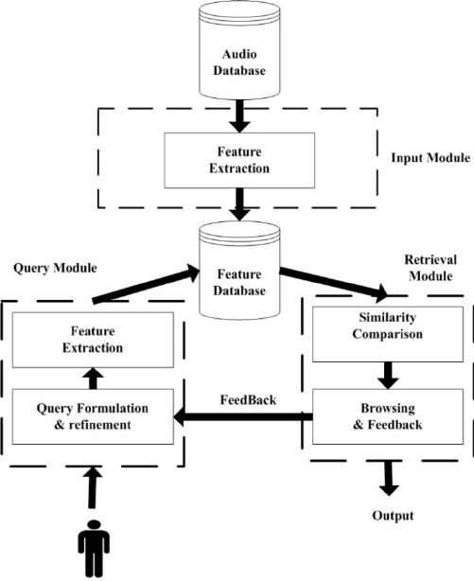
MODULE 6 ..PART1..IRS IMAGE VIDEO TEXT
8)audio information retrieval….

Slide 25
MODULE 6 ..PART1..IRS IMAGE VIDEO TEXT
8)audio information retrieval….
a)Recognizing and Transcribing the content of Radio. programs, Telephone conversations, Recorded Meetings. Music-related retrieval. Music similarity, Music style classification, Instrument. recognition.
b)Music information retrieval (MIR) is the interdisciplinary science of retrieving information from music.
c)This process involves several audio analysis tasks, which may include multi-pitch detection, onset detection, duration estimation, instrument identification, and the extraction of harmonic, rhythmic or melodic information
d)MIR is being used by businesses and academics to categorize, manipulate and even create music.

Slide 26
MODULE 6 ..PART1..IRS IMAGE VIDEO TEXT
9) Video information retrieval….
a)The objective of video retrieval is as follows: given a text query and a pool of candidate videos, select the video which corresponds to the text query. Typically, the videos are returned as a ranked list of candidates and scored via document retrieval metrics.
b)Content-based Video Retrieval refers to the provision of search facilities over archives of digital video content, where these search facilities are based on the outcome of an analysis of digital video content to extract indexable data for the search process.
c)Their main advantages include the ability to represent and manage complex objects, handle object identities, encapsulate data and associated methods into objects, and inherit attribute structures and methods based on class hierarchy

Slide 27
MODULE 6 ..PART1..IRS IMAGE VIDEO TEXT
9) Video information retrieval…. Process….
1)select the target video
2) As per the frame rate select the number of frames
3) Remove the redundant frames by sampling and comparison
4) Remaining frames are the target frames
5) Separate the background of the frames from the foreground by using any background subtraction method
6) Frames have only the foreground i.e objects. This object can be retrieved as the OFI(object of interest)
For object detection ..object identification and marking is done…object identification can be colour, shape , geometry or texture based

Slide 28
MODULE1 ..PART3..IRS
Thank You

